Slide 1








Avionté 24/7 WORK
MARKETING KIT
Avionté © Copyright 2023 All Rights Reserved.
avionte.com | @avionte | 651.556.2121

Slide 2
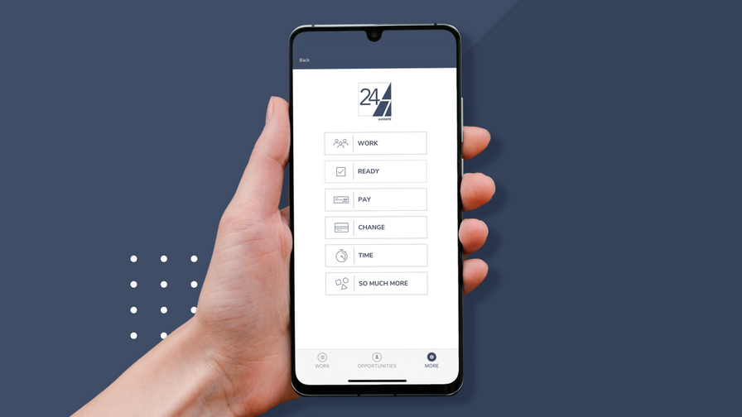
Communications Kit
This communications kit is designed to help clients effectively manage the adoption of a new technology app within their organization and communicate its benefits to internal teams, clients, and talent.
Feel free to customize the provided templates to fit your organization's specific needs.
Avionté © Copyright 2023 All Rights Reserved.
avionte.com | @avionte | 651.556.2121
02

Slide 3
This kit includes guidelines for...
01
Internal Communications
02
Client Communications
03
Talent Communications
Marketing Checklist
04
Avionté © Copyright 2023 All Rights Reserved.
avionte.com | @avionte | 651.556.2121

Slide 4
Internal Communications
Share the Company Vision for the Future
  Include desired outcomes and the direction the company is heading
  Consider the specific benefits for each audience within your organization:
C-Level Executives
  Increased efficiency
  Improved decision-making
  Strategic insights
Leadership
  Streamlined processes
  Enhanced collaboration
  Data-driven decision-making
Sales
  Improved customer engagement
  Enhanced sales processes
  Increased revenue
Recruiters
  Enhanced candidate experience
  Improved talent acquisition
  Streamlined hiring processes
Operations
  Improved productivity
  Streamlined workflows
  Optimized resource allocation
Avionté © Copyright 2023 All Rights Reserved.
avionte.com | @avionte | 651.556.2121

Slide 5
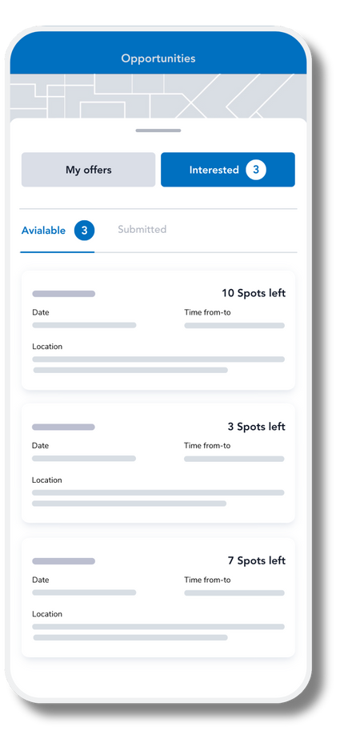
Internal Planning for Change
How it Works:
  Provide an overview of how the app functions and its key features
Changes and Impact:
  Summarize the current and future state of online staffing, highlighting the changes brought about by the new app
Anticipate Objections and Overcoming Them:
  List potential objections at each level and provide a plan to address them effectively
  Address concerns, clarify misconceptions, and provide supporting evidence or testimonials
  Example: Recruiters fear that computers are taking over their jobs. But actually this is empowering them to get more done and focus on relationships.
Communications Calendar:
  Share the rollout strategy and timeline
  Ensure each level understands when to expect communications and their role in supporting them
  Include communication plans for candidates and clients, and solicit support from team members.
Avionté © Copyright 2023 All Rights Reserved.
avionte.com | @avionte | 651.556.2121

Slide 6
Client Communications: Planning for Change
How it Works:
  Provide an overview of how the app functions and its key features to your clients.
Changes and Impact:
  Summarize the current and future state of online staffing, highlighting the changes brought about by the new app
  Explain how these changes will improve your relationships with your clients and the benefit to them
Anticipate Questions & Answers:
  List potential questions and how you plan to address those.
Communications Calendar:
  Share the rollout strategy and timeline
Avionté © Copyright 2023 All Rights Reserved.
avionte.com | @avionte | 651.556.2121

Slide 7


Client Communications
Target Client Audiences
*customize messaging for each client
  Current Clients
  Prospective Clients
Dear [Client],
We're excited to introduce our new online staffing app, [App Name], designed to revolutionize your staffing experience.
With real-time job notifications and simplified communication, [App Name] allows us to connect you with top talent Instantly and efficiently.
Experience seamless staffing operations and faster access to qualified candidates.
Thank you for your partnership. We look forward to supporting your staffing needs with [App Name].
Best regards,
[Your Name]
[Your Company Name]
Avionté © Copyright 2023 All Rights Reserved.
avionte.com | @avionte | 651.556.2121

Slide 8
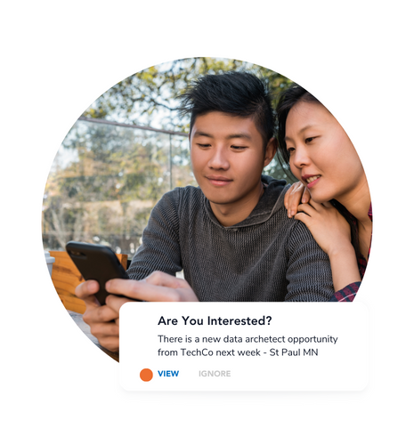
Talent Communications
Best Practices
  Clearly communicate the benefits and added value of using the new app.
  Highlight how the app works and its features that enhance the candidate/worker experience.
There is a new data architect opportunity
from TechCO new week - St Paul MN
Avionté © Copyright 2023 All Rights Reserved.
avionte.com | @avionte | 651.556.2121

Slide 9
Messaging
When, How, and What to Communicate to Talent
Use this template to plan and schedule your communications to talent, including existing employees, applicants, and workers. Consider the appropriate audience, communication method, and dates for each communication.
Communications Calendar | Communications Calendar | Communications Calendar | Communications Calendar
TOPIC | AUDIENCE | METHOD | DATE
App Introduction: Ensure proper expectations of the Smartlink | Existing Talent | Email, Text, Other | Pre-Launch
Call to Action: Download the App | Existing Talent | Email, Text, Other | Launch
Re-Inviting: Include the "Why" - what's In It for them | Existing Talent who has not yet downloaded the app | Email, Text, Other | Post-Launch
In-Person Marketing: Build excitement around your new app | Applicants In-Office, Career Fairs, etc. | Flyers, Posters, QR Codes | Post-Launch
Website | Net New Applicants | Website | Strategy Dependent (Pre/Post Launch)
Digital Marketing Campaigns | Net New Applicants | Social Media, Google Ads, etc. | Post-Launch
Avionté © Copyright 2023 All Rights Reserved.
avionte.com | @avionte | 651.556.2121

Slide 10
Messaging
Communicating the Value Add Example
Jobs come to YOU...
  Accessible Job Opportunities: Discover exciting job openings at your fingertips, providing easy access to a world of possibilities.
  Seamless Application Process: Apply for roles effortlessly while on the move, making job hunting a breeze and saving you valuable time.
  Centralized Management: Enjoy the convenience of a single platform to efficiently handle and organize your work schedules and commitments.
  Heightened Responsiveness: Stay ahead of the game with quick response times, ensuring you never miss out on valuable opportunities.
  Enhanced Experience: Our app is tailored to benefit you, ensuring a smoother and more rewarding job search journey.
  Empowerment and Convenience: Take control of your career and unlock your full potential with our user-friendly and empowering app.
03
Avionté © Copyright 2023 All Rights Reserved.
avionte.com | @avionte | 651.556.2121

Slide 11

Pre-Launch Communications
Summarize the Call To Action
Customize this template to provide a brief overview of your app launch and its call to action for talent when it launches. Highlight features relevant to your organization and app configuration.
Dear [Talent Name],
[CompanyName] has built a strong reputation in the industry through our commitment to delivering incredible experiences. We are excited to announce the launch of our new mobile app, [APP NAME].
With this app, we bring a real-time mobile experience to our candidates, offering instant access to new jobs, the ability to engage with us on your mobile device, and more.
  App features: Highlight features such as one-stop-shop for candidate resources, profile management, in-app notifications for new opportunities, job opportunity and work schedule management, onboarding, referral options, and time reporting (if applicable).
  What's next: When to expect the app invitation (smartlink text) and what to do?
  Contact information: Provide contact details for any app-related questions or support.
Avionté © Copyright 2023 All Rights Reserved.
avionte.com | @avionte | 651.556.2121

Slide 12
Launch Communications
Setting the Expectation
Use this template to provide a call to action for talent. Share instructions on how to download the app and get started.
Page 1
Dear [Talent Name],
Introducing our new mobile app,
[INSERT APP NAME HERE]
[Company Name] is excited to announce the launch of our new mobile app, [App Name]. With [App Name], you can receive real-time notifications about new job opportunities, apply for jobs, manage your work schedule, and sync with your personal calendar.
Getting Started in 3 Easy Steps:
  You will receive a text message with a link to install [App Name] from [insert phone number]
  Click on the link to download and open the app from the app store.
  No username/password required.
Viewing and Applying for Job Opportunities:
  When you receive a job opportunity notification, review the details and click the "Accept/Interested" or "Decline" button.
  If interested, click "Accept/Interested" to let our recruiters know you're interested.
  You can find all your interested jobs under the "Opportunities" tab in the app.
Avionté © Copyright 2023 All Rights Reserved.
avionte.com | @avionte | 651.556.2121

Slide 13
Customize this template by adding workflows that are specific to your organization. (IE: Interest or Offer Jobs)
Page 2
Confirming and Accepting Job Offers:
  Once you've expressed interest or accepted a job offer, you'll receive in-app notifications to confirm and accept.
  By accepting or confirming offers in the app, you can see job details, location, and sync with your calendar.
Reviewing Your Accepted Jobs and Schedule:
  Click the "Work" tab in the app to review your scheduled shifts, organized by date.
  Access shift times, locations, and other details by selecting dates on the calendar.
Cancellation:
  If you need to cancel a scheduled job, please contact [insert info here].
Questions? For any questions regarding [App Name] for iOS and Android, please contact us at [email] or [phone number].
Thank you for using [App Name]! We're here to support you throughout your job search and work experience.
Avionté © Copyright 2023 All Rights Reserved.
avionte.com | @avionte | 651.556.2121

Slide 14
Marketing Asset Updates
Asset | Updates Needed | Owner | Target Date
Website | Update app information, create a landing page, or QR code for your app | [Responsible Person] | [Target Date]
Sales Collateral | Update sales materials to include app features and benefits | [Responsible Person] | [Target Date]
Recruiting Collateral | Update recruiting materials with app information and usage instructions | [Responsible Person] | [Target Date]
Email Signatures | Add a call-to-action and download link for the app in email signatures | [Responsible Person] | [Target Date]
Job Boards/Career Pages | Update job board profiles and career pages with app details | [Responsible Person] | [Target Date]
Social Media | Create posts and updates promoting the app and its features | [Responsible Person] | [Target Date]
Avionté © Copyright 2023 All Rights Reserved.
avionte.com | @avionte | 651.556.2121

Slide 15




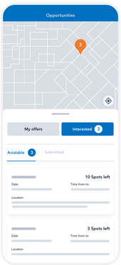


Website Marketing
New Menu Item
How It Works
"Discover Our App"
Redesigned nav bar to have a page dedicated to your new app and the value.
Display app images and a step-by-step guide for easy adoption.
Home Page Images
Social Icons
Share Images of your new app on the home page of your site to show that you're mobile first.
Link to social media. By regularly sharing compelling content on your social platforms, you can increase your social footprint and reach a broader audience.
Avionté © Copyright 2023 All Rights Reserved.
avionte.com | @avionte | 651.556.2121

Slide 16






Get Creative
Leverage Social Media
  Social Media Posts: Regularly post about the app on your company’s social media platforms. Use eye-catching graphics and videos to demonstrate how the app works.
  Influencer Partnerships: Collaborate with industry influencers or well-known professionals in your field to promote the app.
Avionté © Copyright 2023 All Rights Reserved.
avionte.com | @avionte | 651.556.2121

Slide 17

App QR Code
24/7 AGENCY BRANDED only
QR CODE GENERATOR LINK
Avionté © Copyright 2023 All Rights Reserved.
avionte.com | @avionte | 651.556.2121

Slide 18
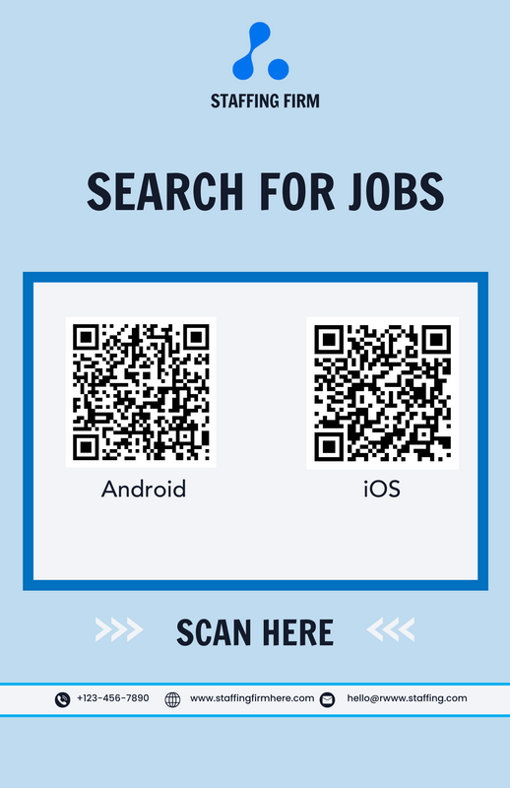
QR CODE GENERATION
Steps
  Find App URLs: After publishing your apps, Google the URLs for your iOS and Android apps.
  Open Canva: Go to Canva QR Code Generator.
  Generate QR Codes: Enter the iOS app URL in the generator and Click ‘Create the QR code’.
  Repeat the process for the Android app URL.
  Create a Flyer: Search for “flyer with QR code” in Canva’s templates.
  Insert both QR codes into the flyer by copy and pasting them.
  Label each QR code as “iOS” and “Android.”
  Save and Share: Download your flyer to distribute.
Avionté © Copyright 2023 All Rights Reserved.
avionte.com | @avionte | 651.556.2121

Slide 19

QR CODE GENERATION
Video
Click here to watch a quick video on how to make your QR Codes
TIP
If you have your mobile apps linked to a page on your website, direct talent to that webpage instead of using separate app QR codes. This gives talent more context on how to use the app and helps consolidate your app information in one place.
Avionté © Copyright 2023 All Rights Reserved.
avionte.com | @avionte | 651.556.2121

Slide 20

Email and SMS Campaigns
  Targeted Emails: Send personalized emails to your talent pool highlighting the benefits of the app, including step-by-step instructions on how to download and use it.
  SMS Notifications: Use SMS to send quick, compelling messages with links to download the app, especially for talents who might not check their email regularly.
Avionté © Copyright 2023 All Rights Reserved.
avionte.com | @avionte | 651.556.2121

Slide 21

Highlight App Benefits and Features
Incentives for Downloads and Usage
Clear Value Proposition: Emphasize the unique benefits of the app, such as easy job search, application tracking, schedule management, and instant notifications about job openings.
User Testimonials and Success Stories: Showcase real-life examples of how the app has helped other talents find jobs quickly and manage their work schedules efficiently.
Referral Programs: Encourage current users to refer friends by offering incentives such as gift cards, bonuses, or additional resources.
Welcome Bonuses: Provide a small bonus or reward for new users who download the app and complete their profile.
Avionté © Copyright 2023 All Rights Reserved.
avionte.com | @avionte | 651.556.2121

Slide 22


Onboarding and Support
User Friendly Onboarding
Ensure the onboarding process is smooth and easy to follow, with tutorials or guides to help new users navigate the app.
Dedicated Support
Offer customer support specifically for app users to help them with any issues or questions they might have.
Avionté © Copyright 2023 All Rights Reserved.
avionte.com | @avionte | 651.556.2121

Slide 23

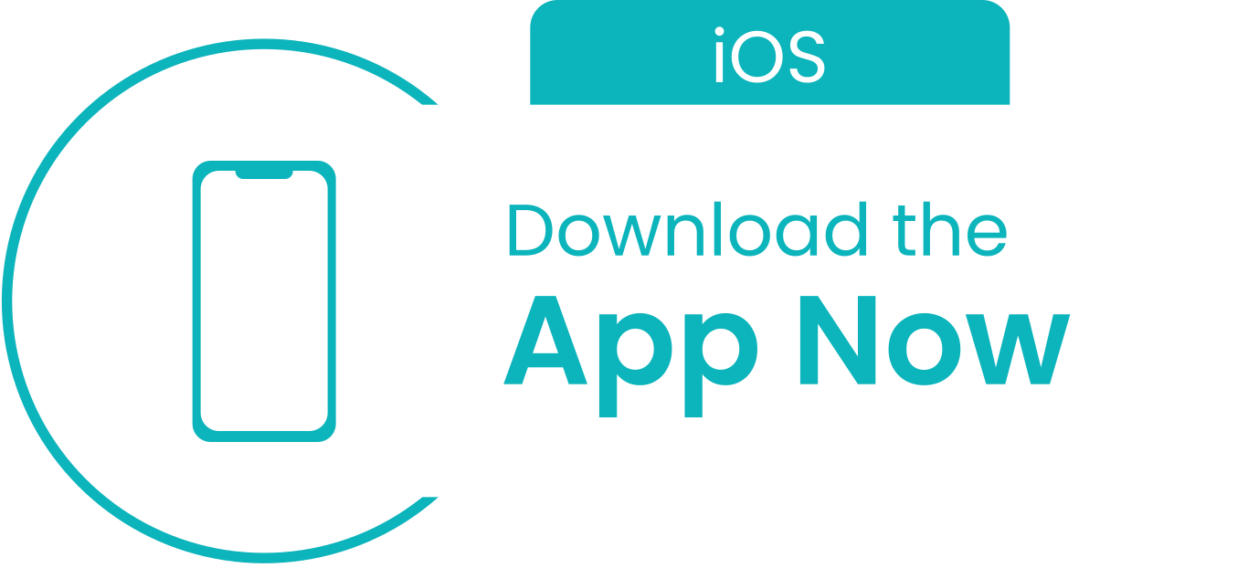
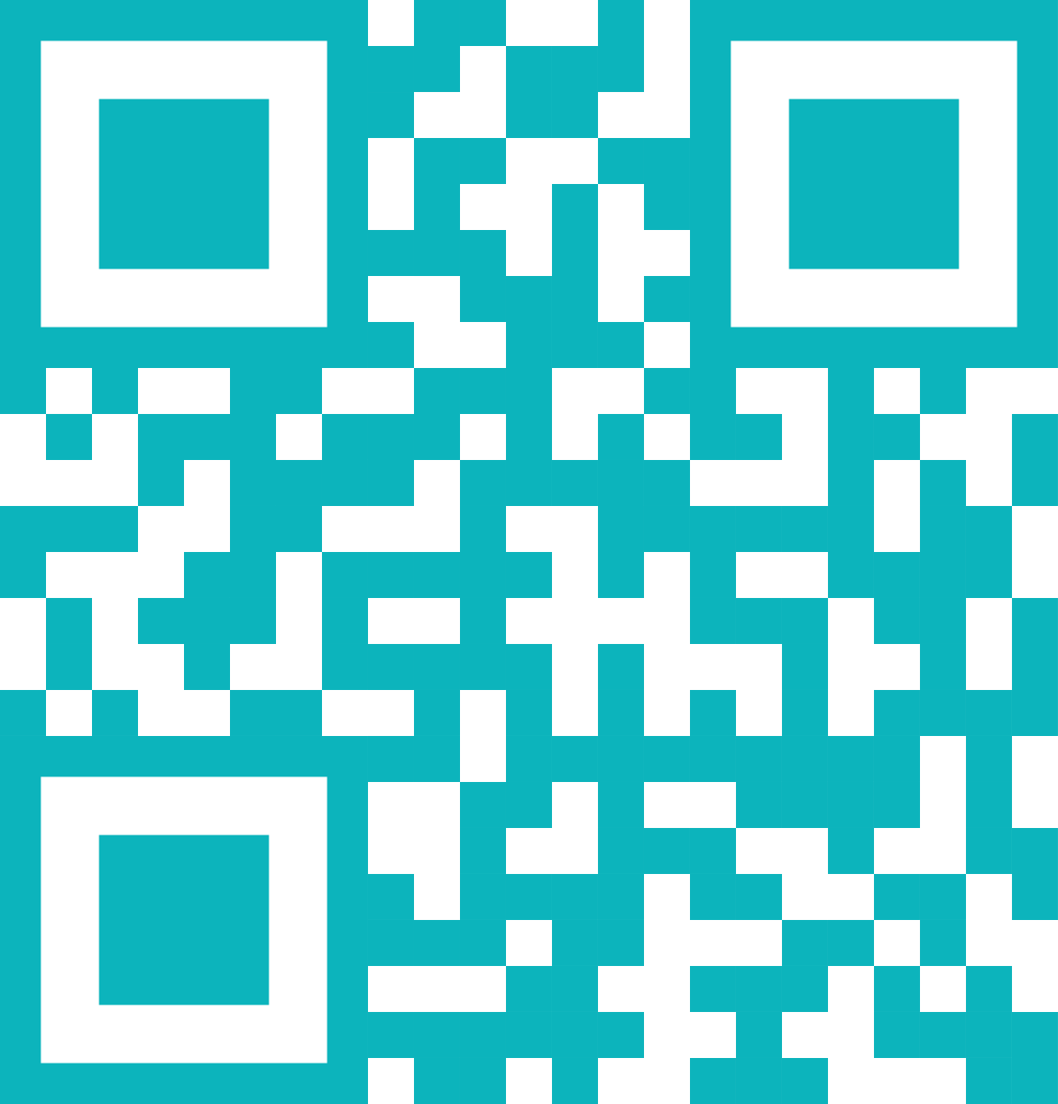



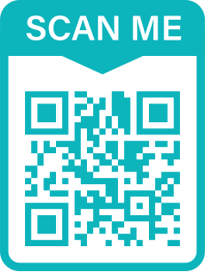

Offline Promotion
Job Fairs and Events
Promote the app at job fairs, workshops, and other industry events. Provide QR codes for easy download.
Printed Materials
Include information about the app in your printed marketing materials, such as brochures, business cards, and flyers.
Avionté © Copyright 2023 All Rights Reserved.
avionte.com | @avionte | 651.556.2121

Slide 24

Content Marketing
Blogs and Articles
Write blog posts or articles about the app’s benefits, tips for using it effectively, and success stories from users.
Video Content
Create engaging video content, such as tutorials, user testimonials, and feature highlights to share across various platforms.
Avionté © Copyright 2023 All Rights Reserved.
avionte.com | @avionte | 651.556.2121

